Slide 1
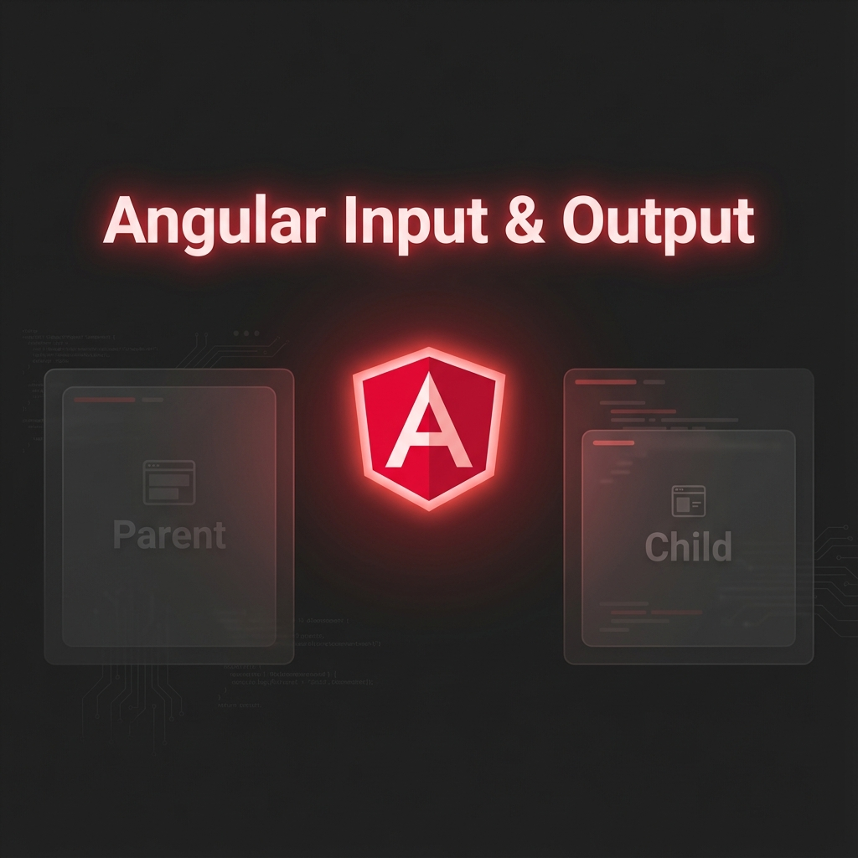
Notes:
Angular Input and Output.
Concept and code explained together — the easy way."

Slide 2
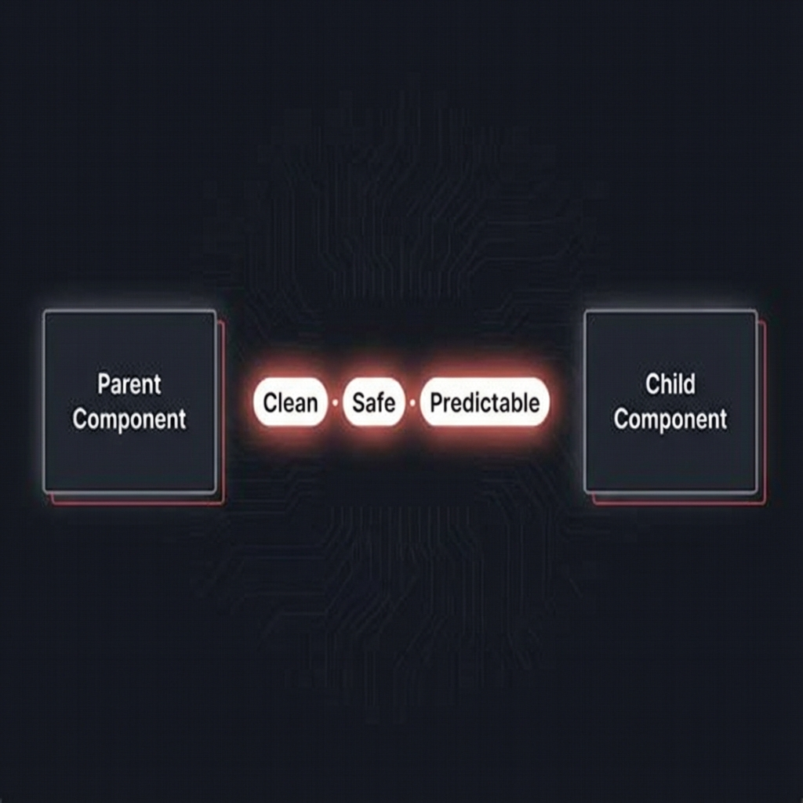
Notes:
If you understand this pattern,
you understand how Angular components talk — cleanly, safely, and predictably."

Slide 3
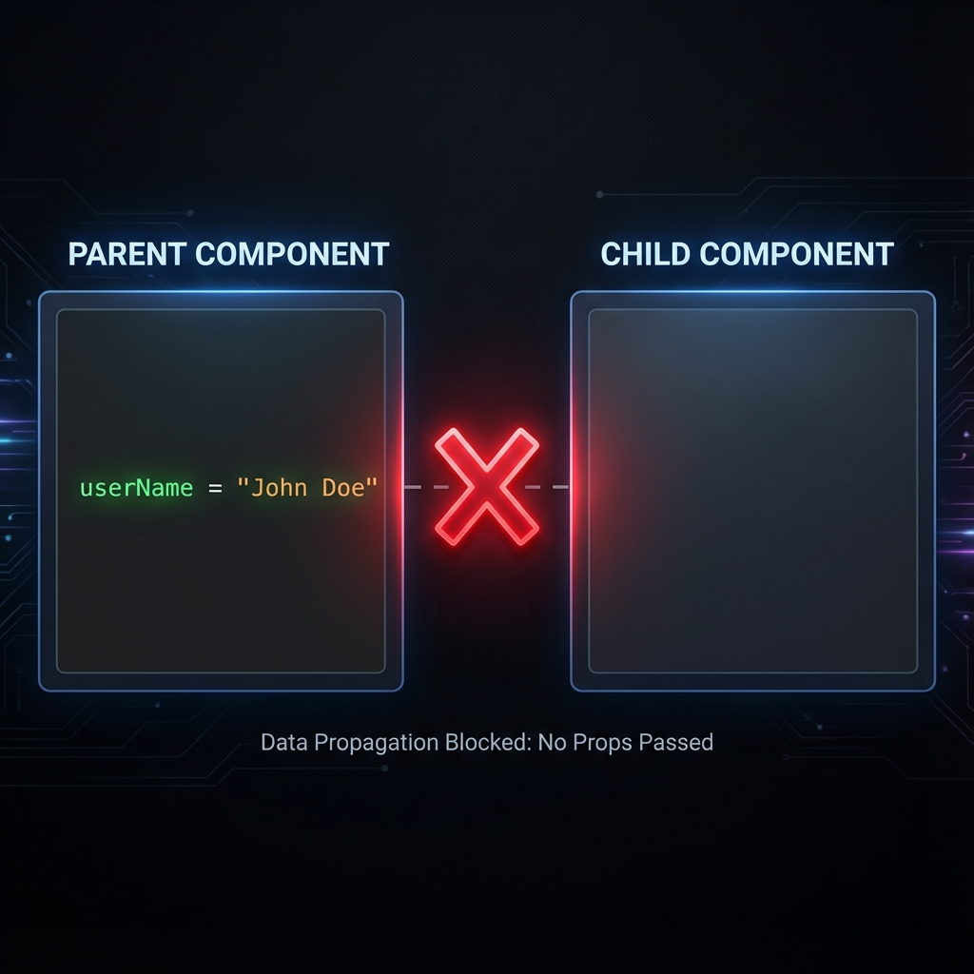
Notes:
Imagine two components — a parent and a child.
By default, they are completely isolated."

Slide 4
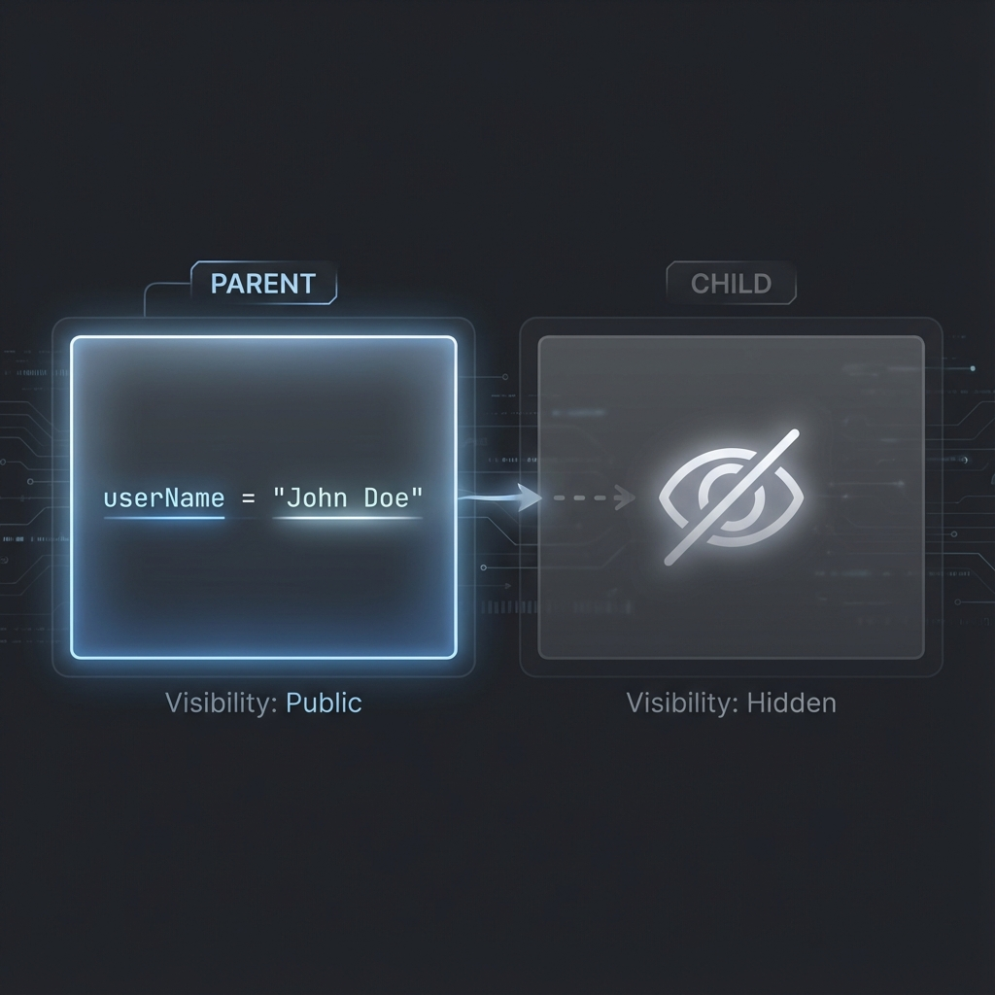
Notes:
The parent has data, like a user name.
But the child cannot see it."

Slide 5
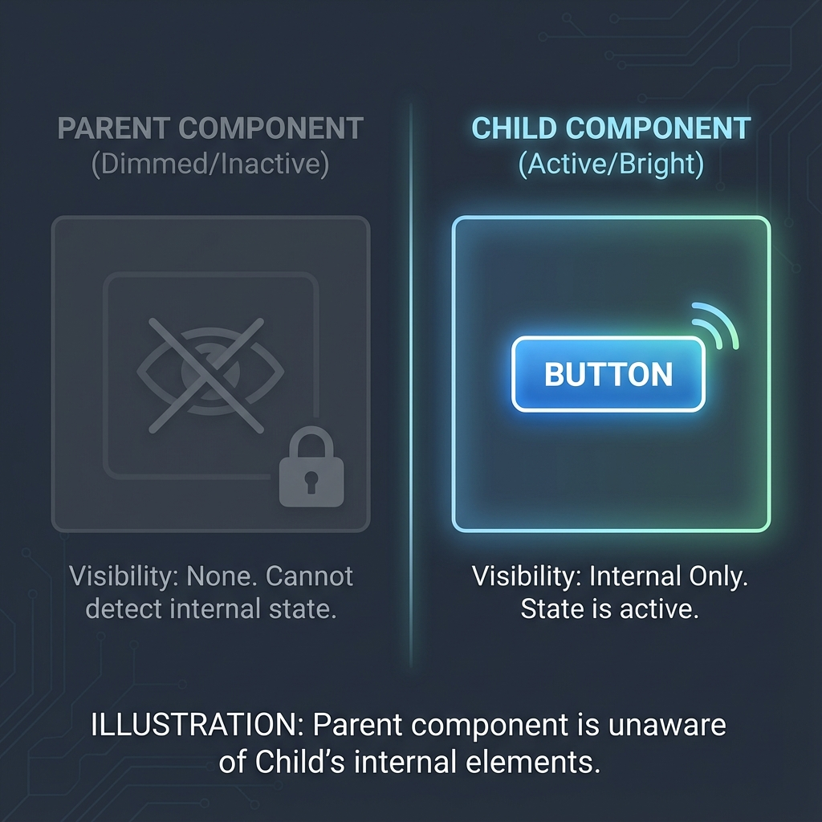
Notes:
And when the child does something,
the parent doesn’t even know it happened."

Slide 6
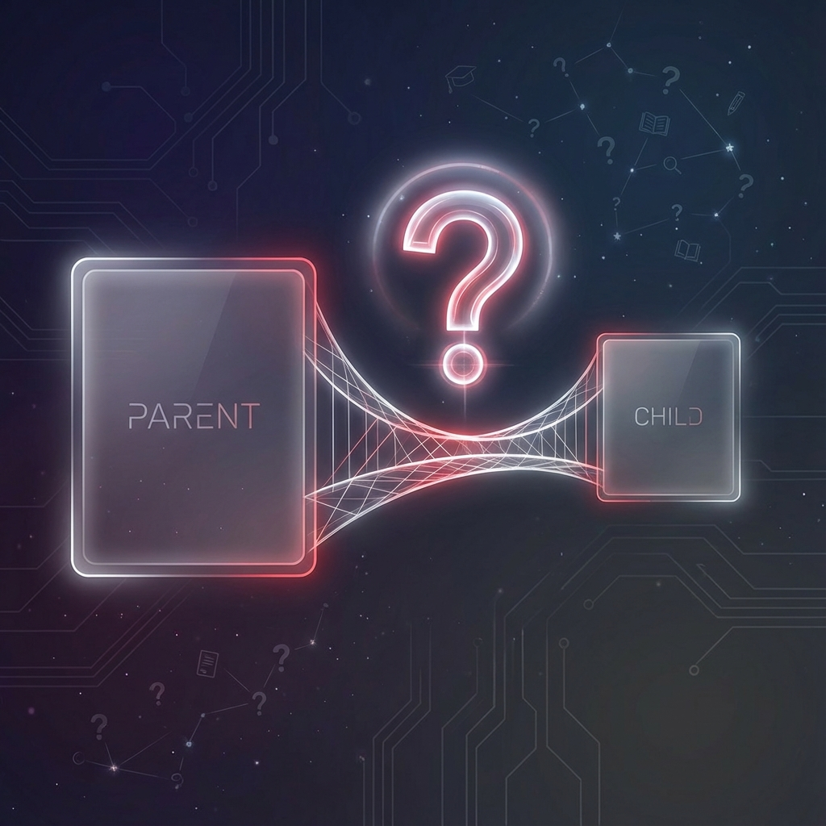
Notes:
So right now, they’re disconnected.
We need a bridge."

Slide 7
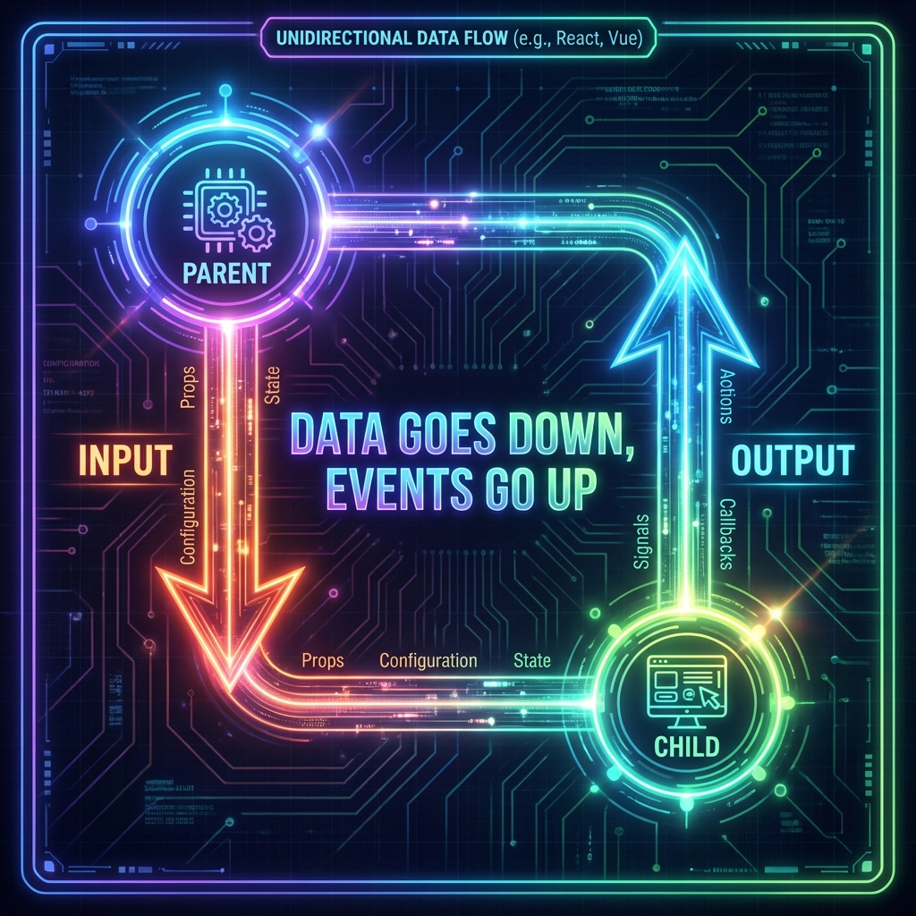
Notes:
(slow & clear)
"Angular gives us that bridge with one simple rule.
Data goes down using Input.
Events go up using Output."

Slide 8
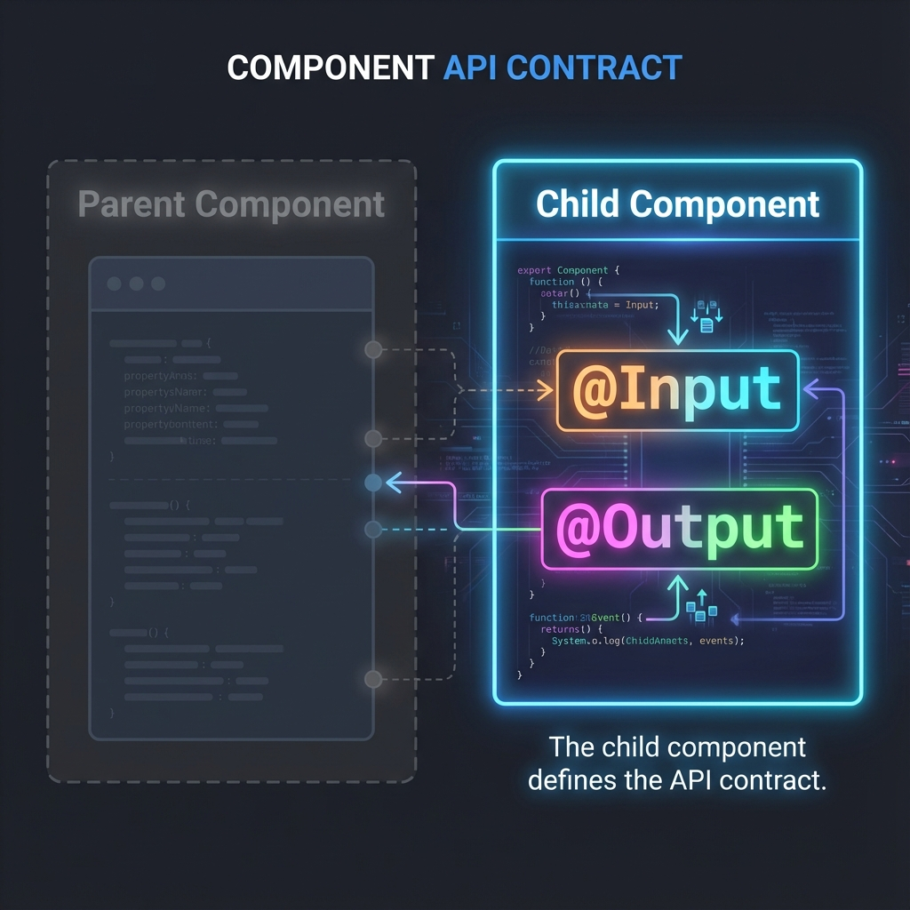
Notes:
Step one — the child component defines the contract.
What data it expects, and what events it can send."

Slide 9
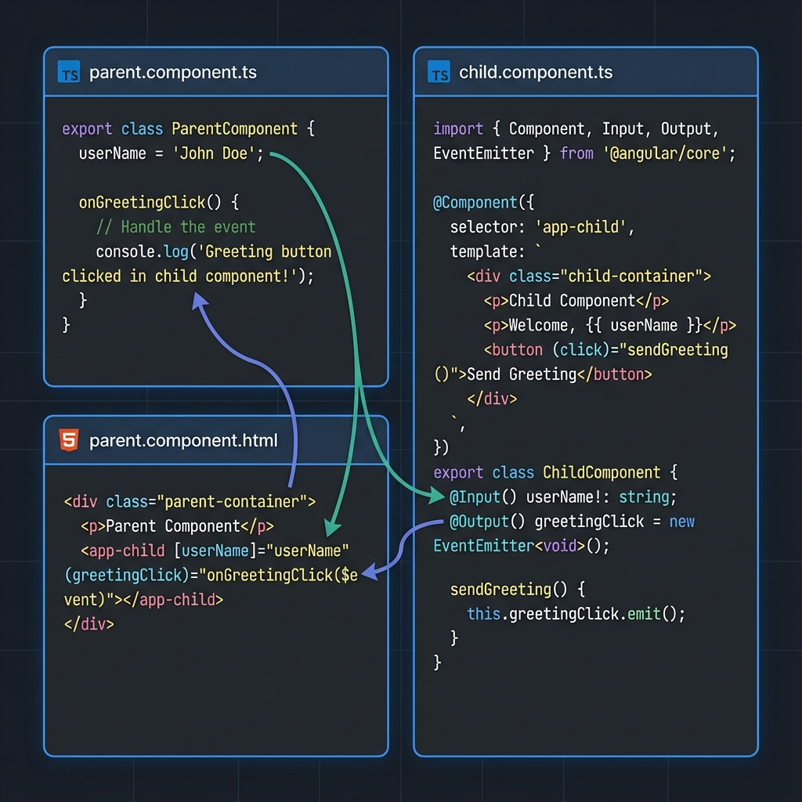
Notes:
Let's look at a real example: a User Profile Dashboard.
The **Parent Component** acts as the smart container. It fetches and holds the user's data, like `userName` and `userAge`.
The **Child Component** is just a dumb specific display. It doesn't know *who* the user is, it just knows how to show *a* user.
We connect them in the template: passing the parent's data down into the child's inputs.
This separation allows us to reuse the child component anywhere!"

Slide 10
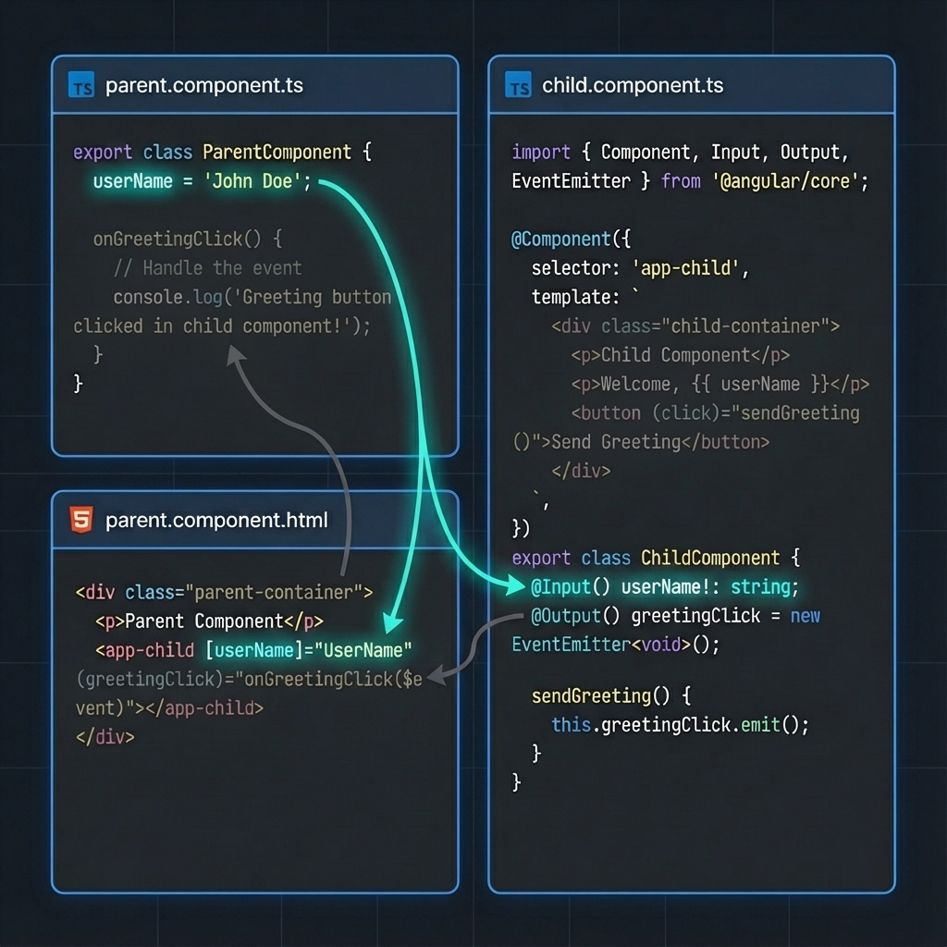
Notes:
In the child component typescript, look for the `@Input()` decorator.
This marks properties like `userName` and `age` as public doorways.
They are waiting for data to flow down from the parent."

Slide 11
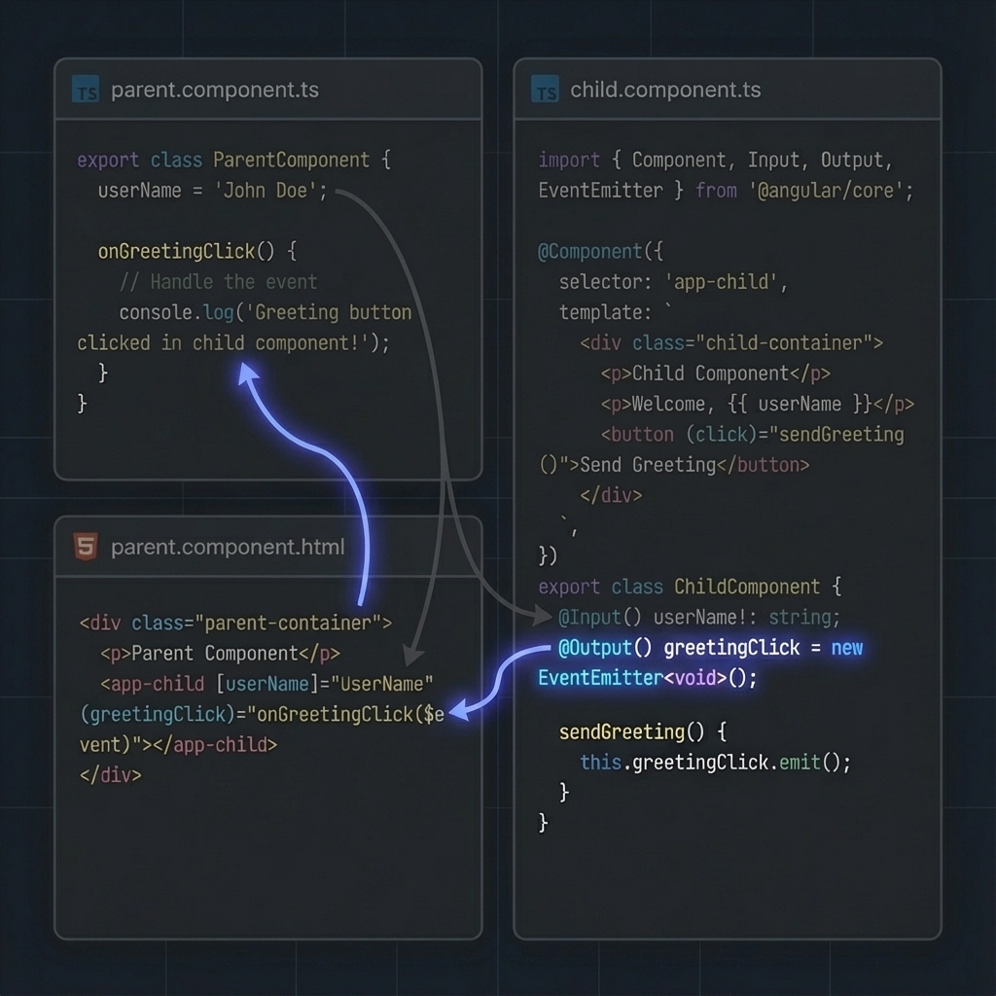
Notes:
For events going up, we use the `@Output()` decorator with `EventEmitter`.
Here, `greetingClick` and `colorClick` are the specialized channels the child uses to talk back to the parent."

Slide 12
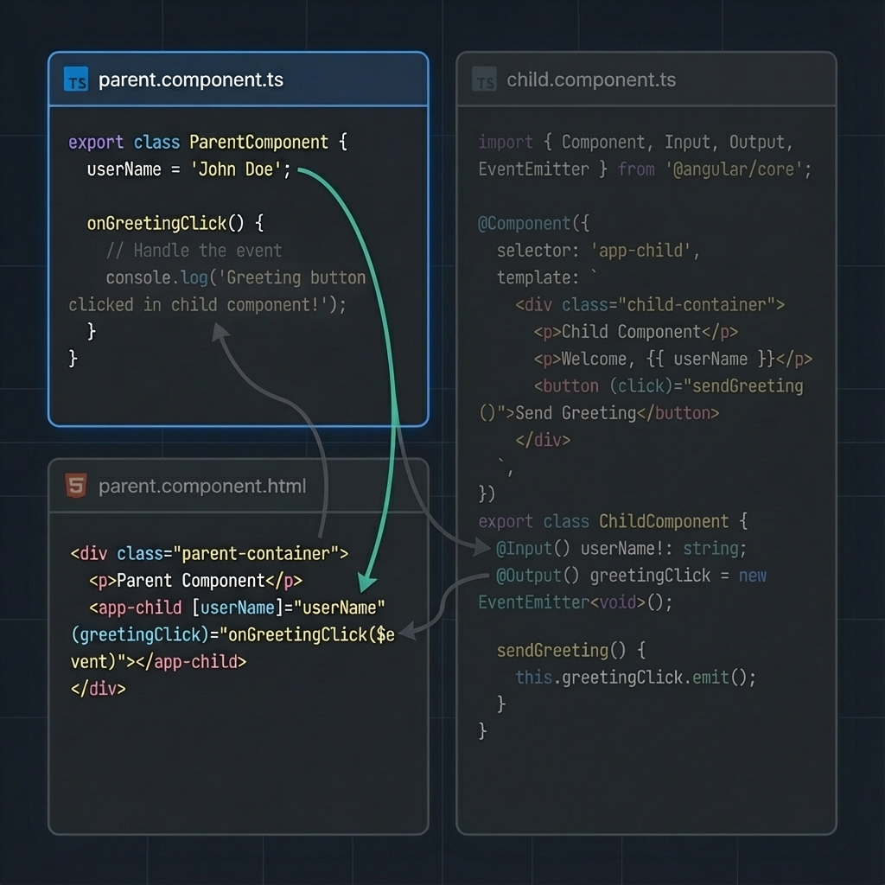
Notes:
Back in the Parent Component, notice the properties `userName` and `favoriteColors`.
These are normal class properties.
The parent owns them, modifies them, and is the single source of truth."

Slide 13
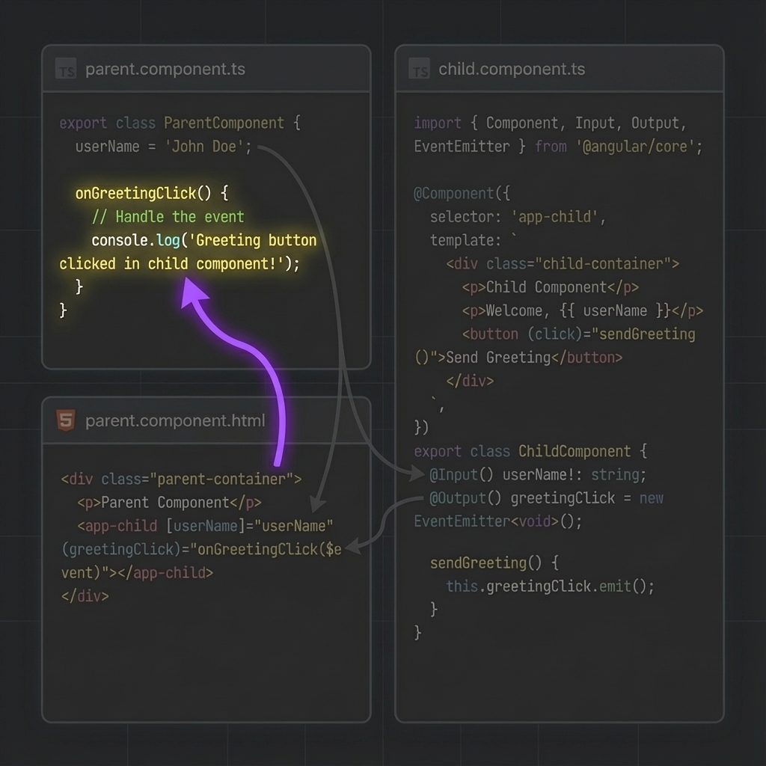
Notes:
The parent also defines handler methods like `onGreetingClick`.
These methods receive the `$event` data payload—in this case, a simple string message—and decide how to update the state."

Slide 14
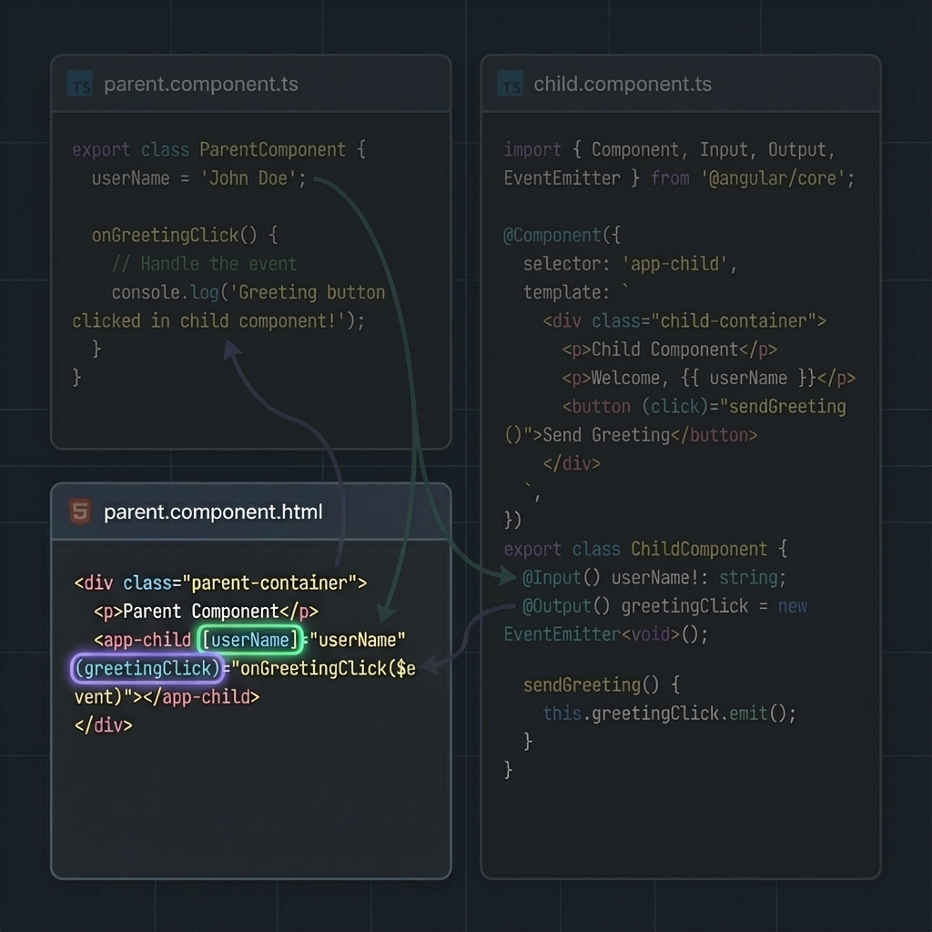
Notes:
The magic happens in the HTML template.
We wrap `[userName]` in square brackets to bind the parent's data to the child's input.
We wrap `(greetingClick)` in parentheses to bind the child's event to the parent's handler."

Slide 15
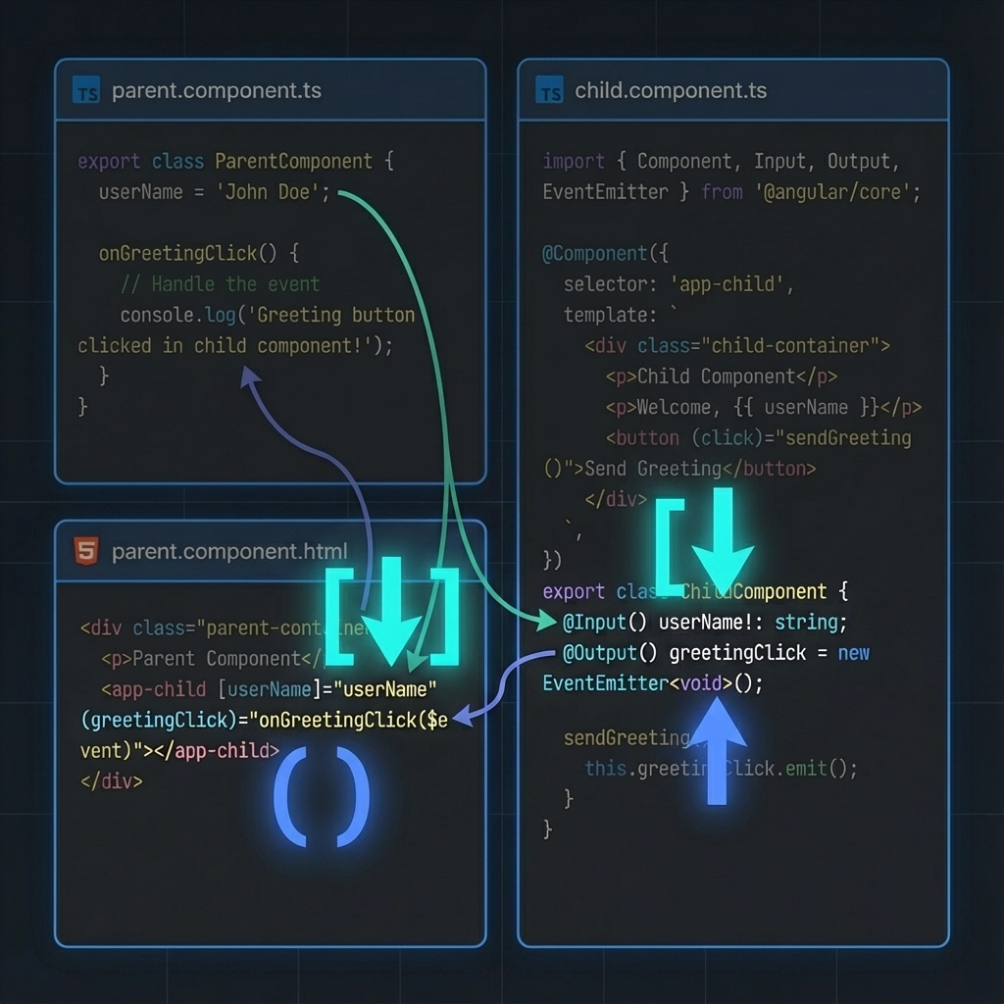
Notes:
(emphasized)
"Here is the rule to memorize:
**Square brackets [ ]** are for Data going **Down**.
**Parentheses ( )** are for Events going **Up**."

Slide 16
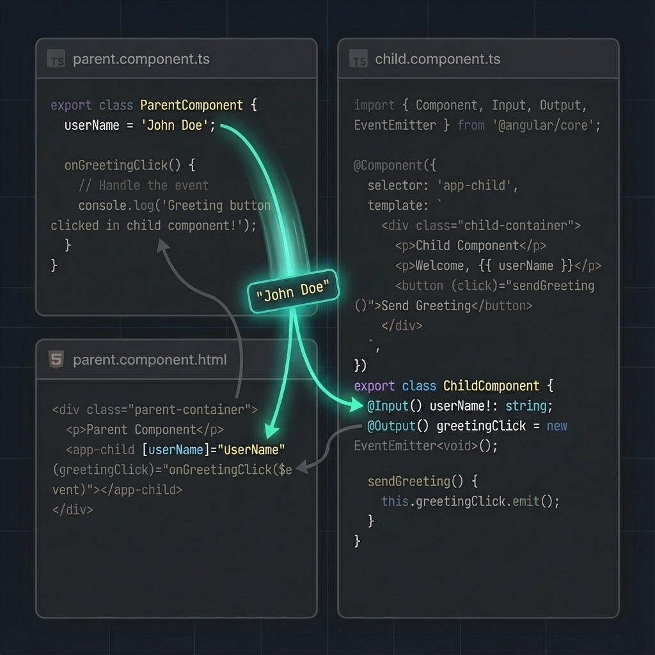
Notes:
When the parent calls `changeName()`, it updates its local `userName` property.
Angular's change detection sees this and instantly pushes the new string down through the `[userName]` binding to the child."

Slide 17
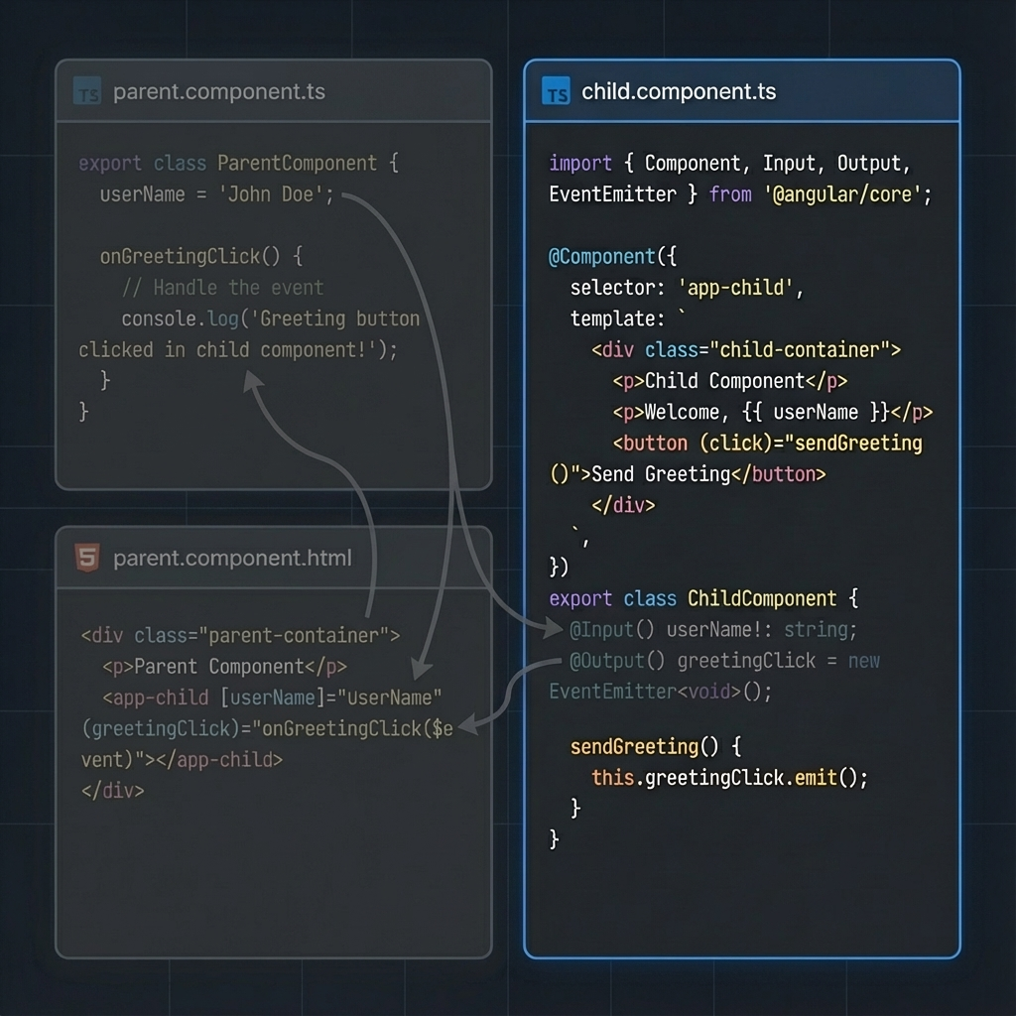
Notes:
Now, imagine the user clicks the greeting in the child component.
The child's `onGreetingClick()` method runs and calls `this.greetingClick.emit(message)`."

Slide 18
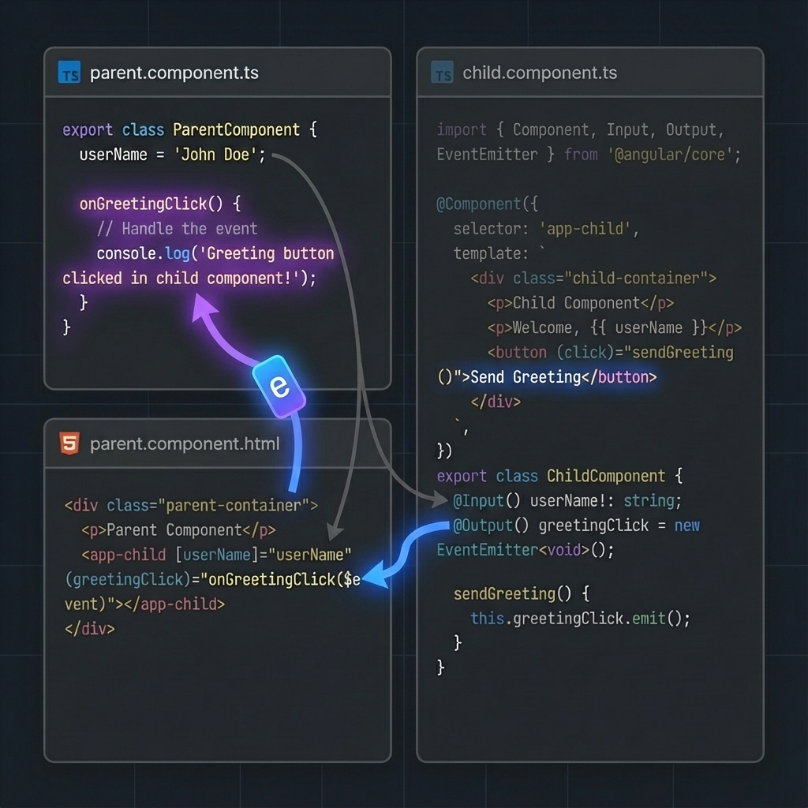
Notes:
That `emit()` function fires the event upwards.
The parent catches it in `onGreetingClick($event)`, logs the message, and the cycle is complete."

Slide 19
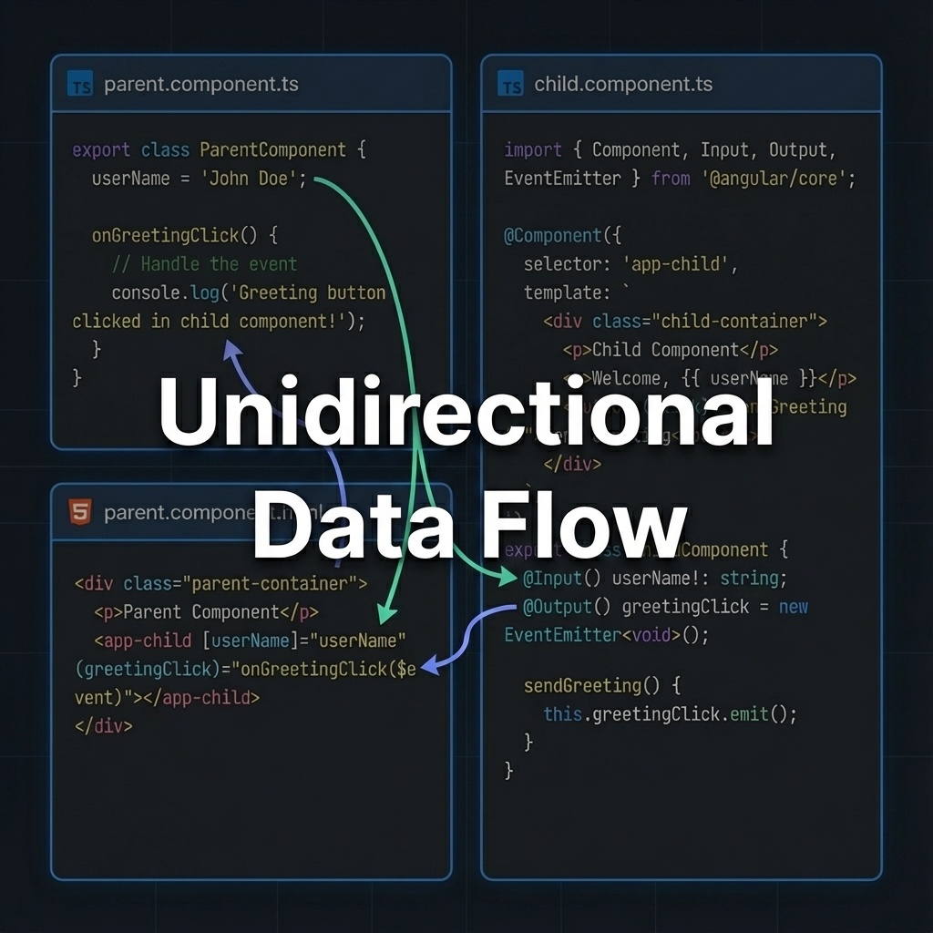
Notes:
Data flows down via properties.
Events flow up via emitters.
This one-way circle is called **Unidirectional Data Flow**.
It keeps your application logic predictable and easy to debug."

Slide 20
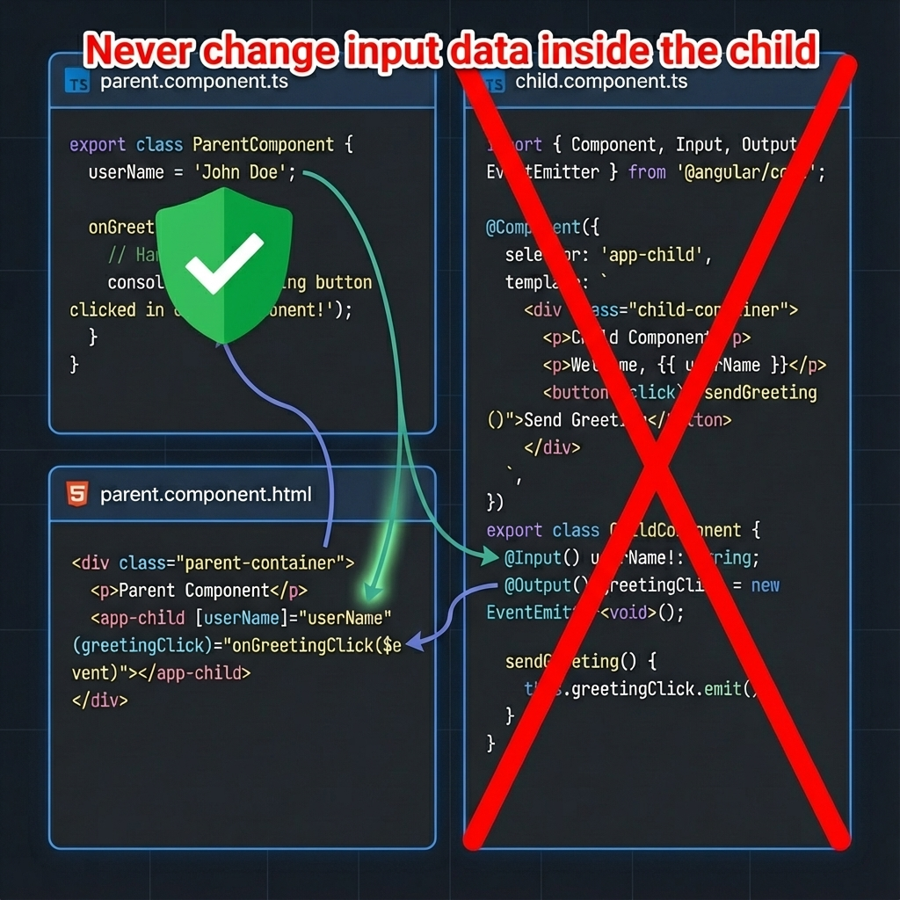
Notes:
Never change input data inside the child.
The parent owns it — always."

Slide 21
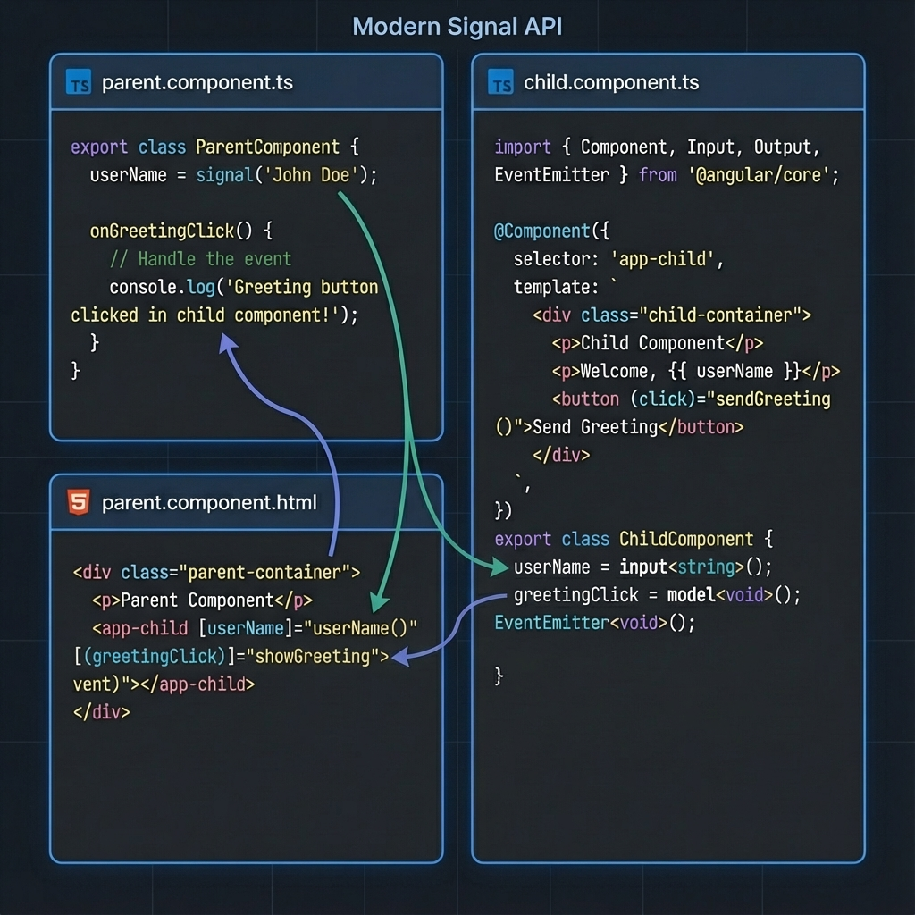
Notes:
In modern Angular, we use Signals.
Cleaner syntax, better performance —
but the same exact idea."

Slide 22
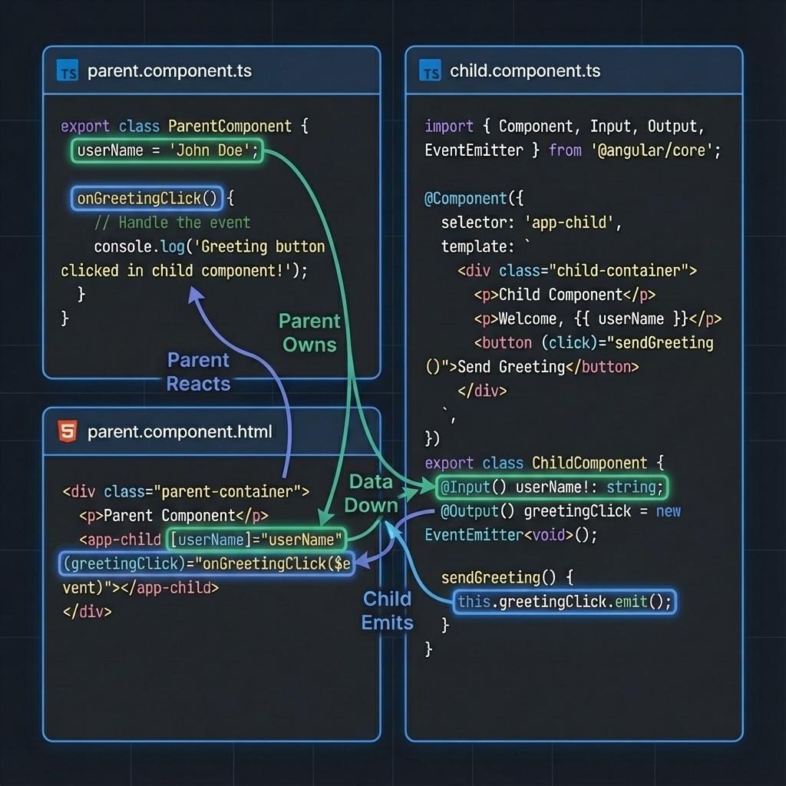
Notes:
Parent owns data.
Child receives data.
Child emits events.
Parent reacts."

Slide 23
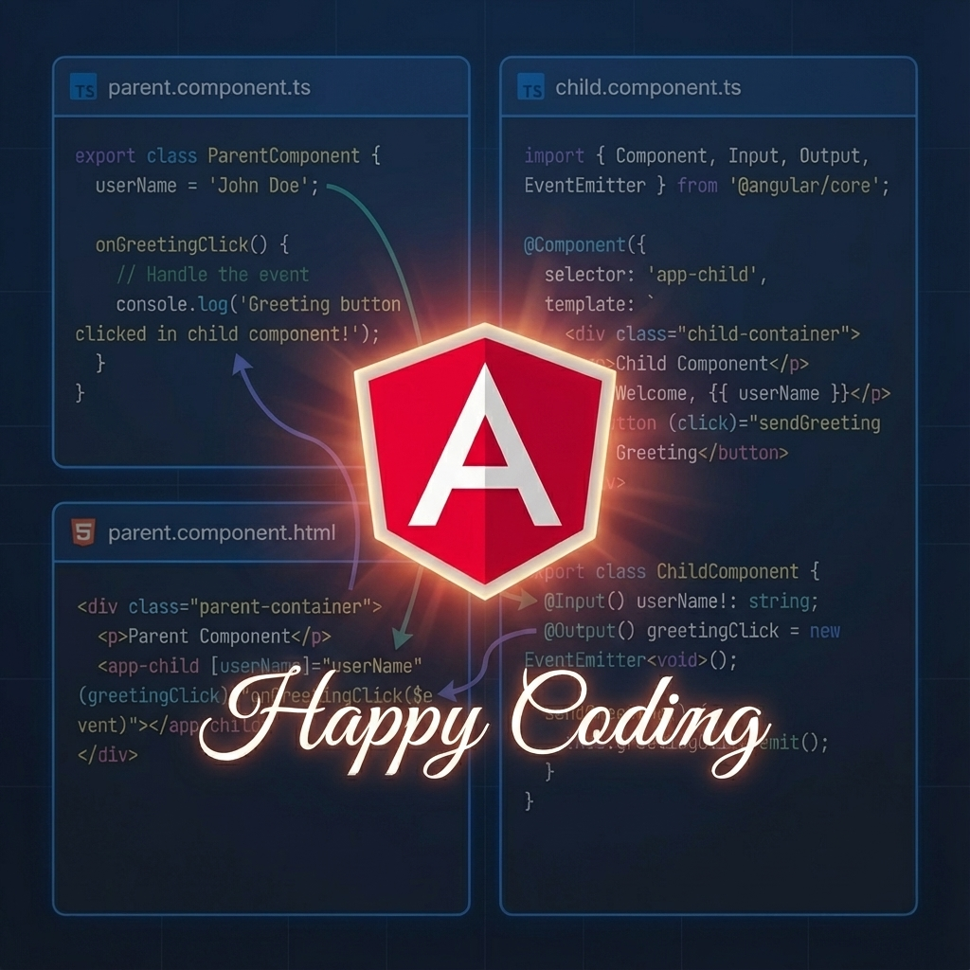
Notes:
If you remember this flow,
Angular communication will never confuse you again.
Happy coding.

